Slide 1
Tritt Elementary

Slide 2
Meal Prices
Lunch
Student $2.35
Reduced $0.40
Guest $3.75
Federal regulations require that school nutrition programs charge certain amounts for meals for students, teachers and guests.
Student lunch prices vary based on school level. For up to date pricing check out: http://www.cobbk12.org/centraloffice/foodservices/mealPrices.aspx

Slide 3
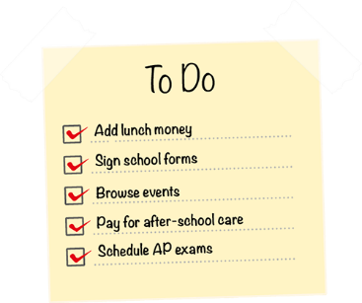
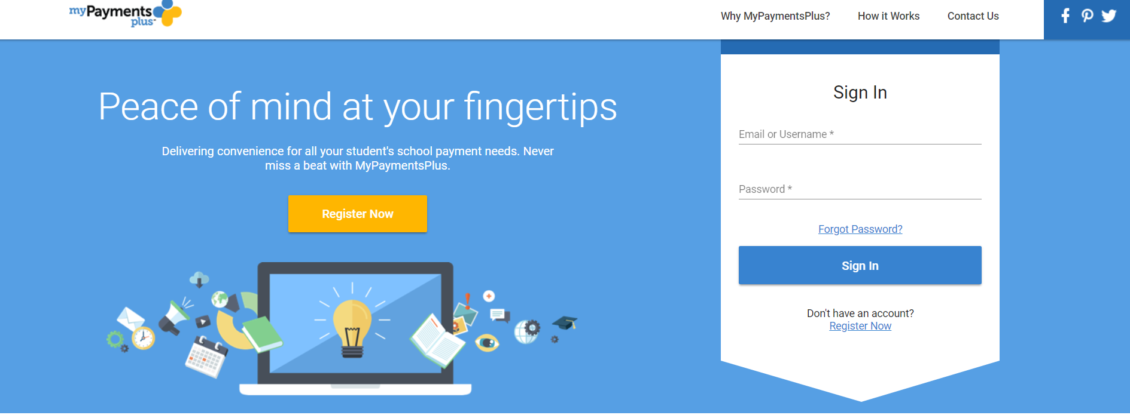
Payment Options www.mypaymentsplus.com
Make the hustle of the school day easier on yourself! Add lunch money online for your convenience.

Slide 4
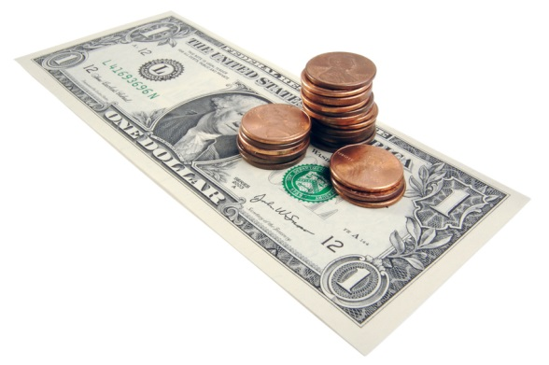
Payment Options
Cash
Include student’s name and ID &
Indicate “Meal Payment” on an envelope
Check
Include student’s name and ID
Write checks payable to:
School Name Café

Slide 5
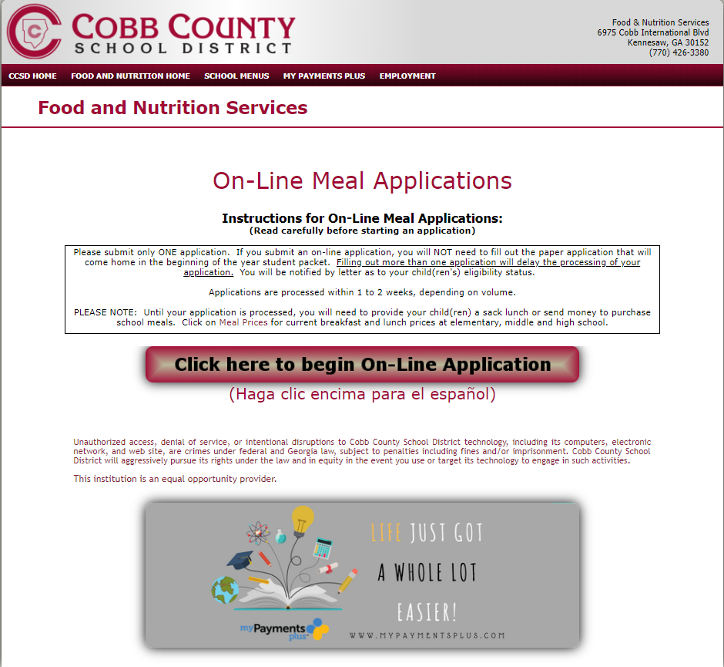
Applying for Free or Reduced Lunch http://mealapps.cobbk12.org

Slide 6
Paper Application
Paper applications will be available upon request at the school.

Slide 7
Charge Policy
Cobb County school administration has a adopted a limited charge policy.
If a student arrives at school without money, they are allowed up to $7.05 in charges at elementary school and $5.20 at middle school.
Charges are not allowed for a la carte, adults, or at high school.
For elementary and middle school only, if a child arrives at school without money for lunch and has reached the charge limit, he/she will be provided with an alternate meal (such as a peanut butter sandwich and milk or cheese sandwich and milk).
No alternate meal will be provided at breakfast.

Slide 8
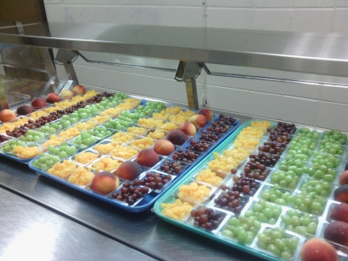
Meal Choices
A minimum of 3 entrée choices available daily including at least 1 vegetarian option
Fresh fruits and vegetables served daily and Georgia or locally grown features monthly
To meet federal regulations and encourage healthy eating, students must select at least one fruit or vegetable with their meal

Slide 9
Allergies and Special Restrictions
Please inform the school nurse and myself of any food allergies!

Slide 10
Customer Service
We are here to help!
Beth DeLeva 770-514-2531
This institution is an equal opportunity provider.

